Slide 1
10/6/25

Slide 2

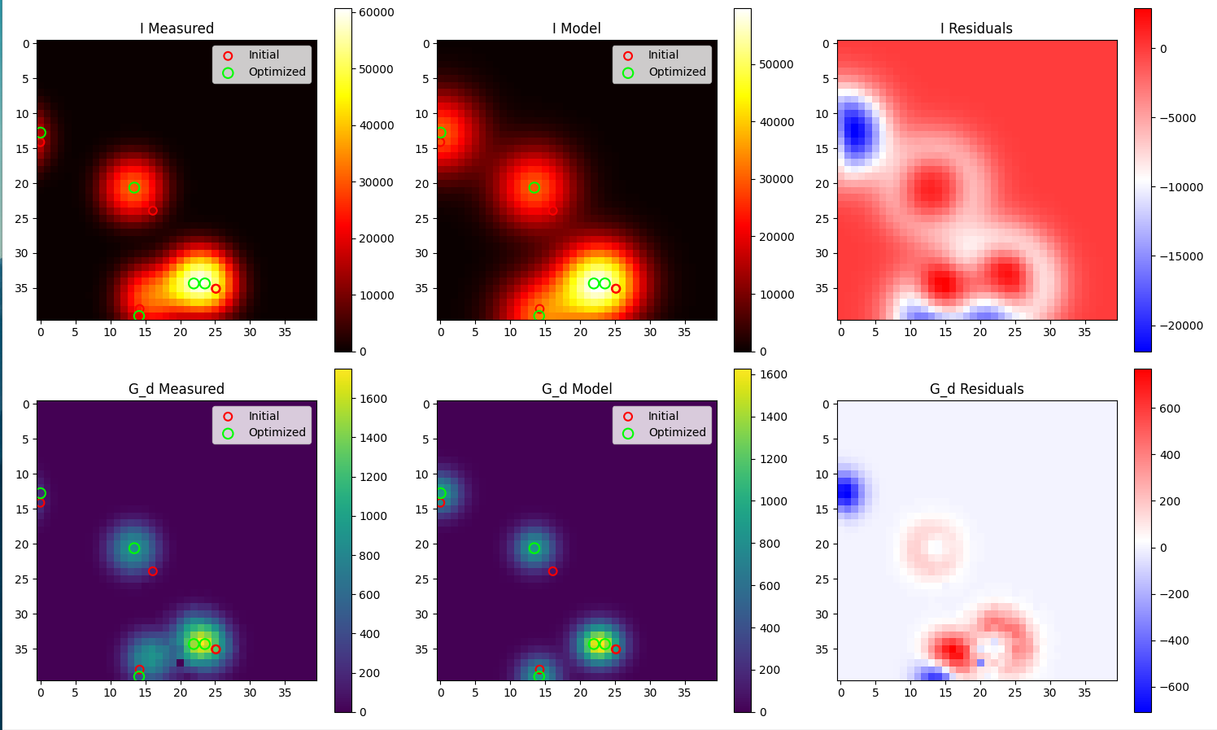
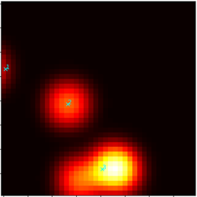
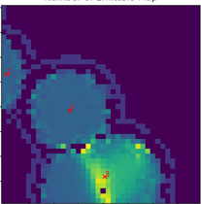
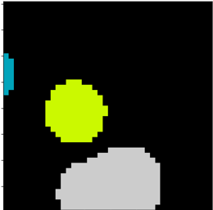
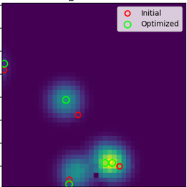
Localization workflow
Added regularization for emitter count
Notes:
Determines ROI using filtering.
Estimate emitter count per ROI by taking maximum over the ROI.
Use centroids of ROI as initial positions with then umber of emitters being equal to the count found in (2). Then optimizing with RSS, optimizing with a small change in the emitters/ROI and comparing.

Slide 3


Slide 4
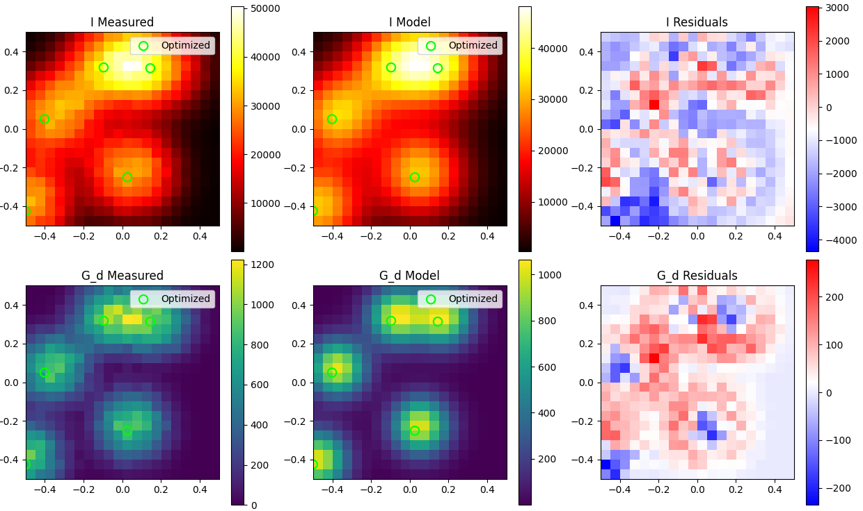

Slide 5
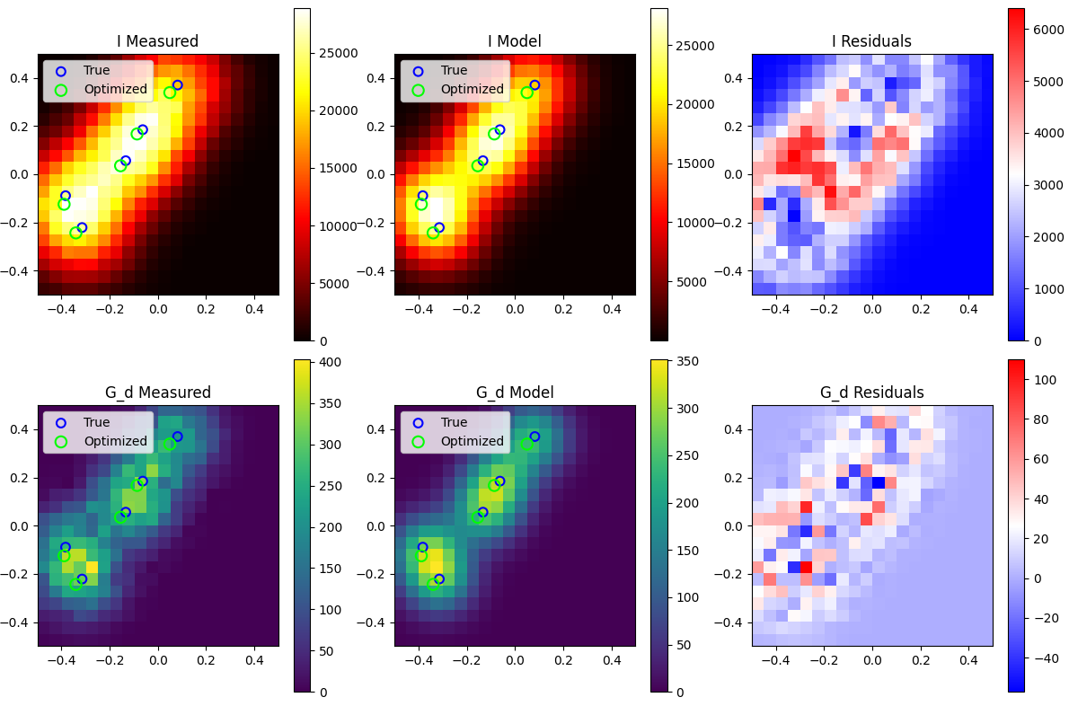

Slide 6


Slide 7
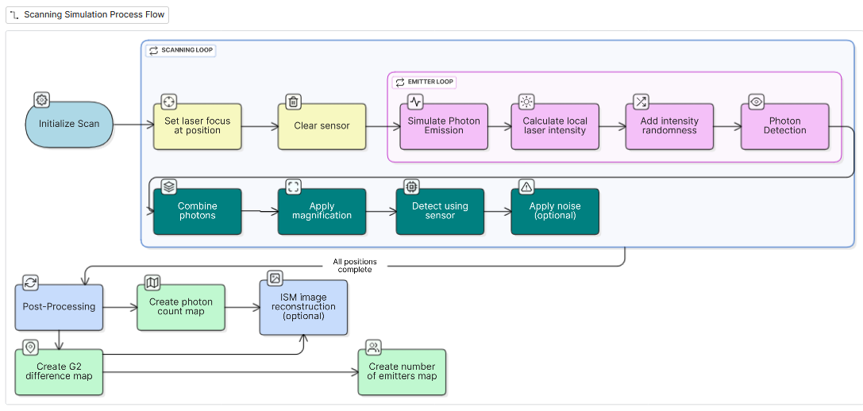

Slide 8
